Slide 1
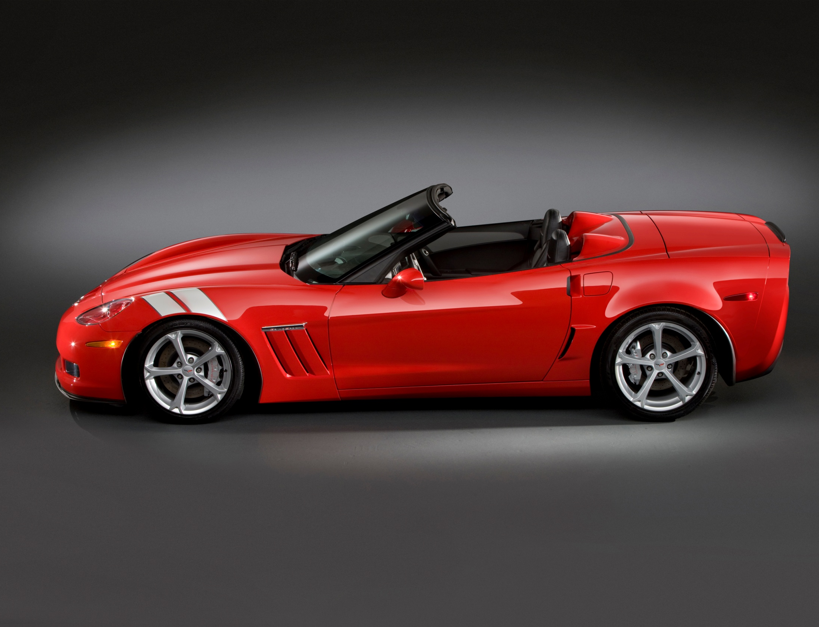
2010 Corvette Grand Sport
0-60 mph 4.0 seconds
Skid pad 1.0 g
EPA Hwy 26 MPG

Slide 2
Key points
2010 Grand Sport is a new separate Corvette model
Grand Sport replaces the Z51 Performance Package as the highest performance LS3 powered Corvette
Grand Sport has serious performance hardware to make it the highest performance removable roof coupe and convertible
Grand Sport is the highest performance automatic Corvette
Grand Sport manual coupe includes standard Z52 dry sump performance package and is the recommended choice for the track
Z52 is n/a for convertible or and coupe with automatic
PRICING IS NOT ANNOUNCED !!!!!
If asked for pricing all we can say it will cost less than the Z06 more than standard Corvette
2010 Order guides went to dealers May 4
Z06 remains a very unique model as the lightest most focused Corvette available with it’s 7.0 (427) LS7 505hp, aluminum frame fixed roof structure and carbon fiber fenders/floors etc.
Z06 and ZR1 will continue

Slide 3
2010 Corvette Grand Sport – RPO Z16
2010 Grand Sport content
Grand Sport – wider body coupe and convertible - aggressive look
Goodyear F1 supercar tires - wider size – 275/35-18x9.5 and 325/30-19x12
New Grand Sport specific wheels: Silver, Competition Gray or Chrome
Specific unique fender design and integrated Grand Sport badge in cove
Front splitter and tall rear spoiler
Functional brake ducts and extra cooling
Larger 6-piston 14” front & 4-piston 13.4“ rear brakes with silver painted calipers
Specific manual transmission ratios and automatic transmission rear axle ratio
More aggressive shocks, stabilizer bars, and springs
Z52 dry sump package with rear battery and diff cooler on manual coupe
1LT / 2LT / 3LT / 4LT packages, all exterior colors and interior colors available
Heritage package with fender hash mark stripes (4 colors) and special two-tone seats with ‘Grand Sport’ embroidery available option
2010 Grand Sport Benefits
1.0 g lateral acceleration vs .92 g standard and .98 g previous Z51
0.2 seconds 0-60 benefit vs standard (4.0 vs 4.2)
Coupe with removable roof and Convertible models (Z06’s are fixed roof only)
6-speed paddle shift automatic available (Z06’s are manual only)
26 mpg highway rating vs 24 mpg for Z06
Less expensive vs Z06

Slide 4
HISTORY of Grand Sport
1963
Corvette purpose-built race car to win Sebring and Le Mans
The envisioned Grand Sport would be the ultimate Corvette, a lightweight, powerful factory built racer.
Only 5 were built out of the planned 125.
1996
The Corvette Design Team wanted to do a fitting 'close' for the long-running C4 body style.
Only 1000 were built all Blue with White stripes and red hash marks.
The 1996 version used the standard Corvette engine (LT4) with wider ZR1 size wheels, tires, and chassis components.
The 2010 version will use the standard Corvette engine with wider Z06 size wheels, tires, brakes, and chassis.

Slide 5
2010 Corvette News
NEW Grand Sport Model – Coupe or Convertible
Grand Sport Heritage Package with Iconic Hash mark Stripes and Seat Embroidery
Grand Sport coupe manual with Z52 Dry Sump Performance Package standard includes rear mounted battery and differential cooler
Torch Red is back – Z06 and ZR1 available in all 8 colors for the 1st time
Launch Control standard with all manual transmissions
6-speed paddle shift automatic - Push and hold feature allows easy return to auto mode using’+’ paddle
Side Airbags standard on all Corvettes
New interior console trim plates - Orbit and Gunmetal patterns
Crossed flag logo embroidery seat option
Convertible includes Z06 style tall spoiler
Z06 and ZR1 now available with cashmere interior
Z06 3LZ package now includes power sport seats and power passenger seat
ZR1 includes PTM - Performance Traction Management Technology
PTM is an advanced system that integrates your Traction Control, Active Handling, and Selective Ride Control systems to enhance racetrack driving consistency and overall performance. With PTM you can now push full throttle while exiting a corner on a racetrack as the system automatically manages your overall acceleration dynamics
Available Competition Gray wheels for ZR1
1 year XM subscription included with 3LT – 2LZ – 3ZR option packages
Cashmere custom leather wrapped interior – interim availability

